Slide 1
Waves

Slide 2
Simple harmonic motion
April 22
cyclical, periodic, repetitive motion… oscillations, vibrations, cycles, rotations, waves…
What affects simple harmonic motion? How is it measured?

Slide 3
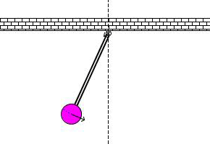
Pendulum
April 22
Swinging mass in simple harmonic motion due to gravity.
Notes:
Day 1 after pendulum lab

Slide 4
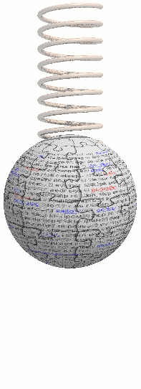
Simple harmonic motion
April 22
Period: time to complete one full cycle (in seconds)

Slide 5
Lab: Just Keep Swinging
April 22
Obj: Experimentally determine how the period of a pendulum is affected by its (1) initial angle, (2) mass, and (3) length

Slide 6
Lab: Just Keep Swinging
April 22
Obj: Experimentally determine how the period of a pendulum is affected by its (1) initial angle, (2) mass, and (3) length
Data: measure the pendulum’s time for 10 swings each for each data point.
Calculations: Period from data. Show proof for one and record all results.
Graphs: one for each independent variable, use the same scale for period on each graph and no scale breaks
Discussion: The usual: be sure you use the graphs to answer the objective; additional task after class review of lab on next slide…

Slide 7
Simple harmonic motion
April 23
What affects a pendulum’s harmonic motion?
Notes:
Discuss lab results

Slide 8
Simple harmonic motion
April 23
The Foucault pendulum swinging at the Chicago Museum of Science and Industry is 20 m long and has a mass of 300 kg. What is the period of the pendulum?

Slide 9
Lab: Just a Swingin’ (cont’d)
April 23
Discussion: The usual: be sure you use the graphs to answer the objective and
Use your pendulum data to calculate the theoretical period of two different length pendulums.
Use the theoretical and measured period to calculate your %error for each of the two pendulums selected.
Percent Error$= \frac{|Theoretical −Experimental|}{Theoretical}x 100$

Slide 10
Simple harmonic motion
April 23
Period: time to complete one full cycle (in seconds)
Frequency: the number of cycles per second (measured in Hz)
Example: A pendulum swings back and forth 10 times in 6 seconds.
T = ?
f = ?

Slide 11
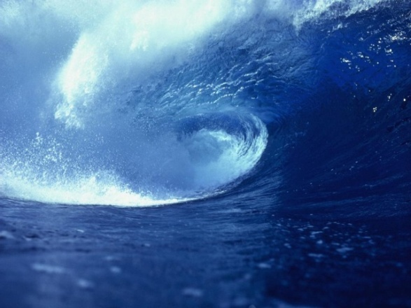
Two main classifications of waves
April 23
Mechanical—waves that travel through (and require) a physical medium (like water, slinky and sound waves)
Electromagnetic—electric and magnetic disturbances that do NOT require a medium (like light and radio waves)

Slide 12
WAVE MOTION
April 23
Energy is transferred by particle interaction or through waves.
A mechanical wave is a regular repeating disturbance which allows the transmission of energy through a medium (matter).
The medium does not move along with the wave.
Notes:
Day 2 before slinky lab

Slide 13
Medium does not travel
April 23

Slide 14
The direction in which the energy is transferred through a wave is called the propagation of a wave
The particles of the medium vibrate perpendicular to the propagation of a transverse wave
April 23
Notes:
Day 2 before slinky lab

Slide 15
Parts of a Transverse Wave
April 23
Crest
λ
Wavelength
A
Rest position
A - Amplitude
Trough
Notes:
Day 2 before slinky lab

Slide 16
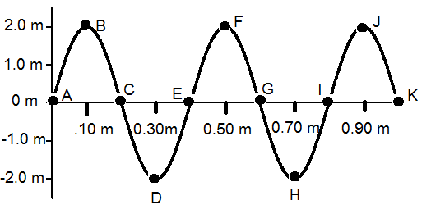
April 23
What is the amplitude of the wave pictured in the diagram?

Slide 17
April 23
What is the wavelength of the wave pictured in the diagram?

Slide 18
April 23
How many waves are pictured in this diagram?

Slide 19
April 23
The total time for the above diagram to happen is 5 seconds. What is the period and frequency of the wave?

Slide 20
April 23
Which points mark the crests of the waves?

Slide 21
April 23
List the letter or letters that locate point(s) that are in phase with the point marked by “c”.

Slide 22
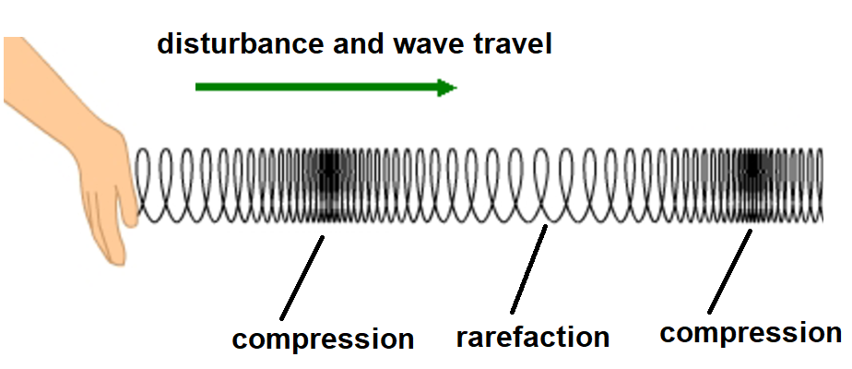
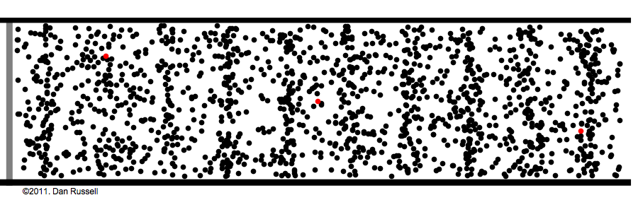
Longitudinal waves
April 24
Disturbance is parallel to the propagation

Slide 23
LONGITUDINAL WAVES
April 24
Rest Position
| | | | | | | | | | | | | | | | | | | | | | | | | | | | |
Wave
|||| | | | | | | | | | | | | | | | | |||| | | | | | | | | | |
rarefaction
compression
wavelength
Notes:
Day 4

Slide 24
WAVE SPEED
April 24
average speed is defined as
Notes:
Day 4

Slide 25
April 24
For a wave, the distance traveled is a wavelength (λ), and the time for the energy to travel this distance is the period (T). So…
or
Notes:
Day 4

Slide 26
The total time for the diagram is 10 seconds. Determine the period, frequency, and speed of the wave?
April 24

Slide 27
Wave interference
April 24
A number of different waves can be in the same place at the same time, the resulting combination is described as interference.
Notes:
Day 4

Slide 28
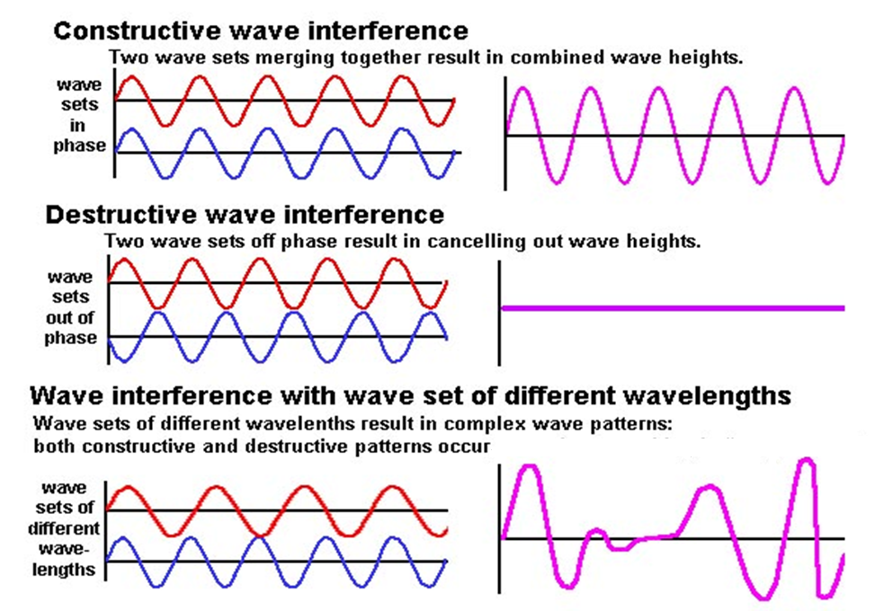
April 24
Notes:
You need to play the slideshow to see everything animated

Slide 29
Interference in a Slinky®
April 24

Slide 30
April 24
Notes:
Car blinker interference

Slide 31
April 24
Notes:
Pendulum interference

Slide 32
Natural Frequency
April 25
All materials have a natural frequency of vibration
The longer an object the lower the natural frequency - pendulum
The thicker the material the lower the natural frequency – guitar strings
Less tension makes it “thicker”
More tension makes it “thinner”
Notes:
Day 4

Slide 33
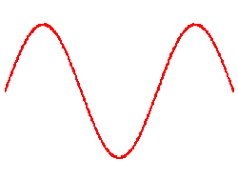
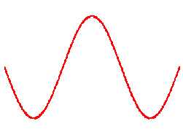
April 25
Notes:
Add in parts and equation for wavelength

Slide 34
Standing Waves
April 25
When two sets of waves of equal amplitude and wavelength pass through each other in opposite directions, it is possible to create an interference pattern that looks like a wave that is “standing still.”
When a wave is reflected off a fixed boundary it “flips over”.
If the waves are produced at a multiple of the medium’s natural frequency, you will not observe the propagation of the wave, only the oscillation.
Notes:
Day 4

Slide 35
April 25

Slide 36
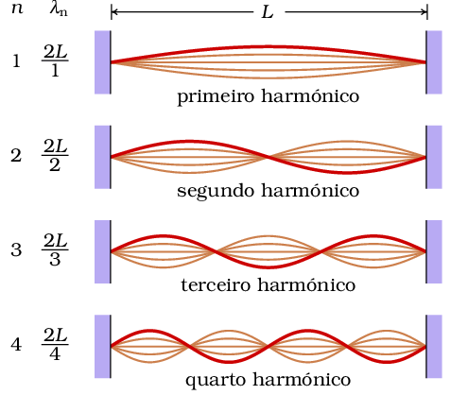
April 26

Slide 37
November 15
is true for all waves.
Note: v is dictated by the medium.
f is dictated by the source.
λ is dependent on the ν and f
Notes:
Day 4

