Slide 1
Unit 3
Newton’s Laws and Forces

Slide 2
February 14

Slide 3
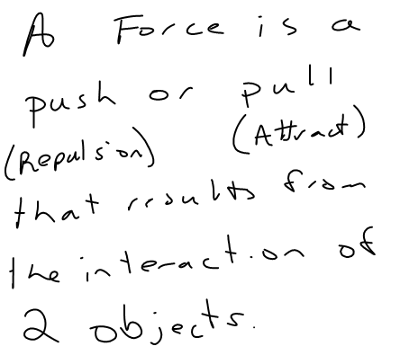
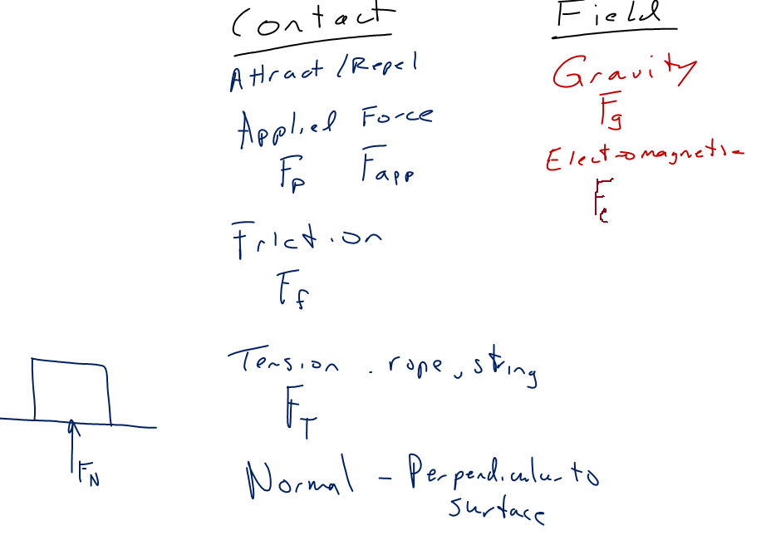
February 14

Slide 4
February 14

Slide 5
February 14

Slide 6
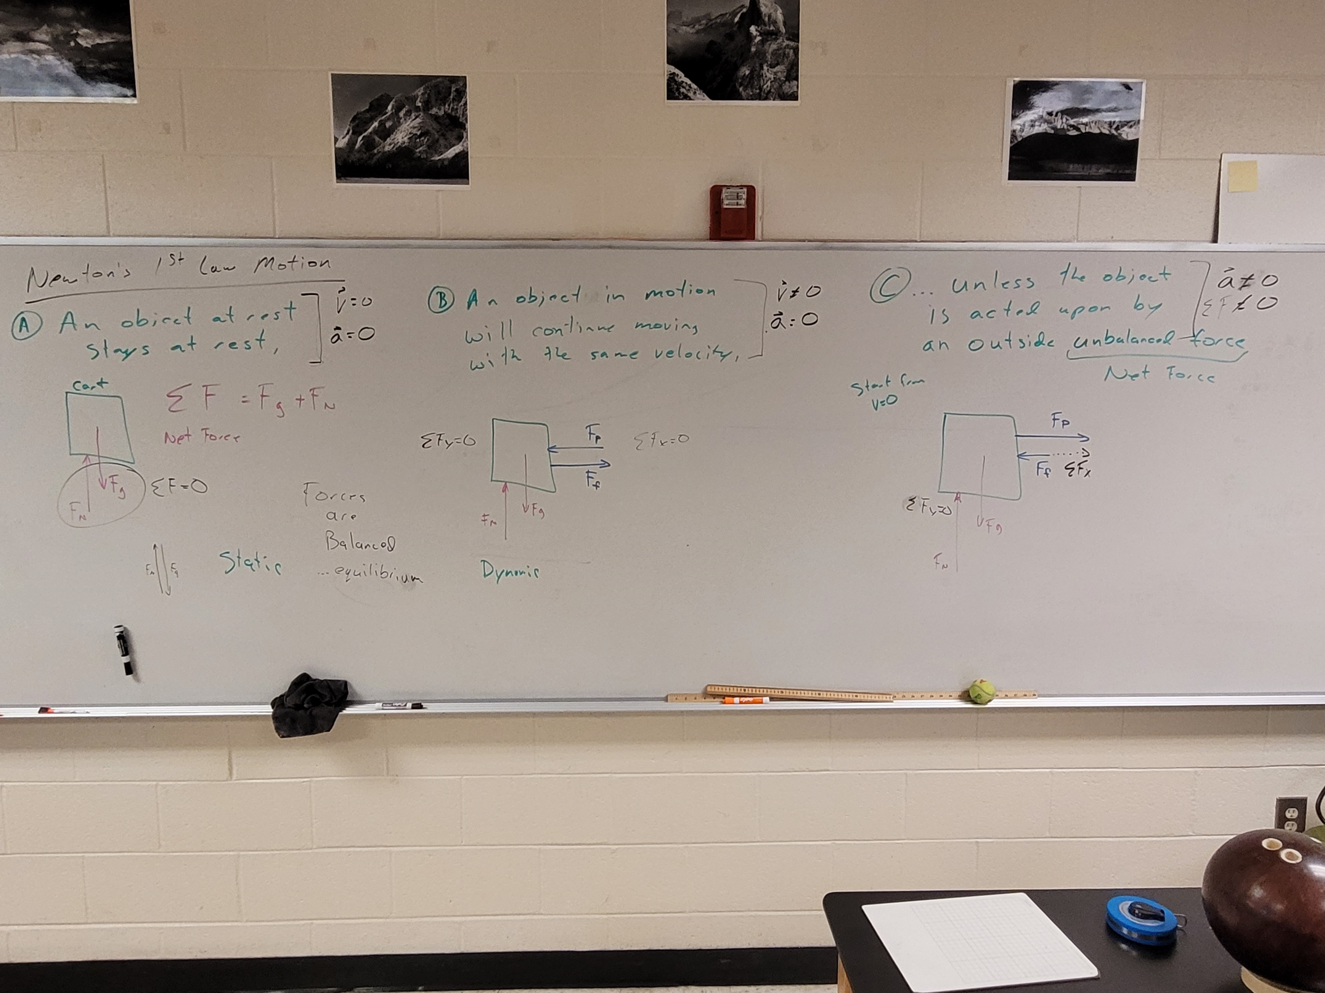
February 15

Slide 7
Lab: May the mass times acceleration be with you
Obj: Experimentally determine the relationship between acceleration, mass, and unbalanced (net) force using graphs of your data from two unique experiments.
Download the SparkVue file from CTLS
Follow provided procedures
Graphs: One graph for each part. Focus on how each graph shows the relationship between the two variables.
Modified Discussion…State the relationship of acceleration with each independent variable. Three diagrams: (a) Set-up and (b) 2 free-body diagrams of (1)cart and (2)hanger.
February 16

Slide 8
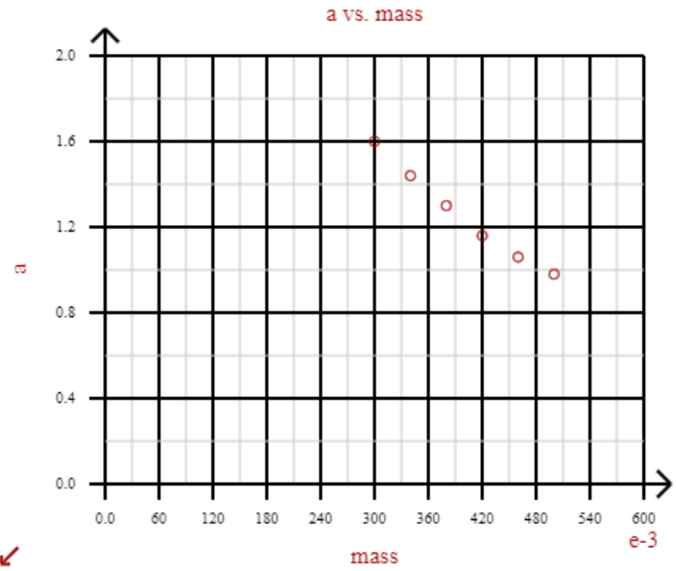
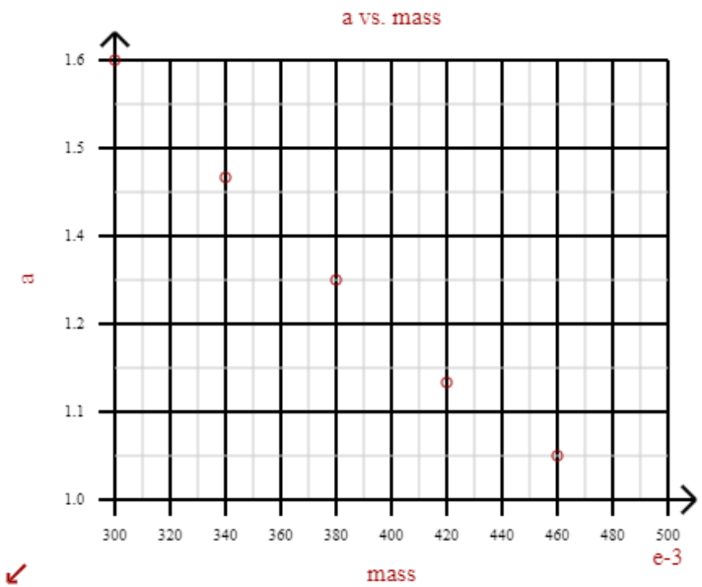
February 26

Slide 9
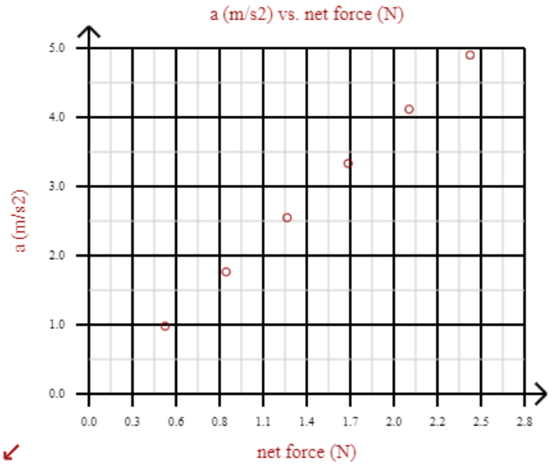
February 26

Slide 10
February 26

Slide 11
February 26

Slide 12
February 27

Slide 13
February 28

Slide 14
February 28

Slide 15
A 5 kg block is pulled with a force of 10 N to the right. The block is observed moving to the right with a constant velocity of 0.6 m/s. What is the coefficient of friction between the block and the table?
Solution on next slide
February 28

Slide 16
February 28

Slide 17
February 29

Slide 18
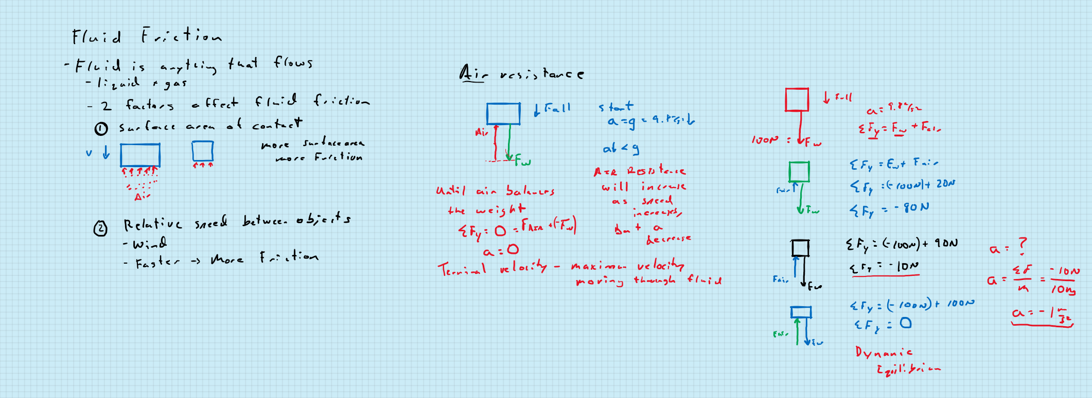
March 1…alternate version

Slide 19
March 1

Slide 20
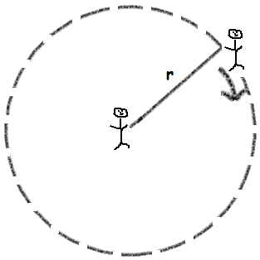
Lab: Round and Round we Go
Objective: Compare the circular motion characteristics of a student walking around a 1 m radius and a 2 m radius circle in the same (± 0.5 s) amount of time.
March 5

Slide 21
Lab: Round and Round we Go
Objective: Compare the circular motion characteristics of a student walking around a 2 m radius and a 4 m radius circle in the same (± 1s) amount of time.
Data: the actual time to walk each circle (do not round off); which circle felt like you were walking faster.
Calculations for each circle: your (a) rotational speed, (b) linear speed, (c) centripetal acceleration, (d) mass, and (e) centripetal force.
As part of your discussion you should identify the actual force that provided the centripetal force (e.g. gravity, friction,…)
March 5

Slide 22
March 5

Slide 23
March 5

Slide 24
March 6

