Slide 1
Motion
January 5

Slide 2
“is relative”
January 5

Slide 3
All motion is relative and must be measured as compared to a “stationary”object or a…
January 5
Frame of reference

Slide 4
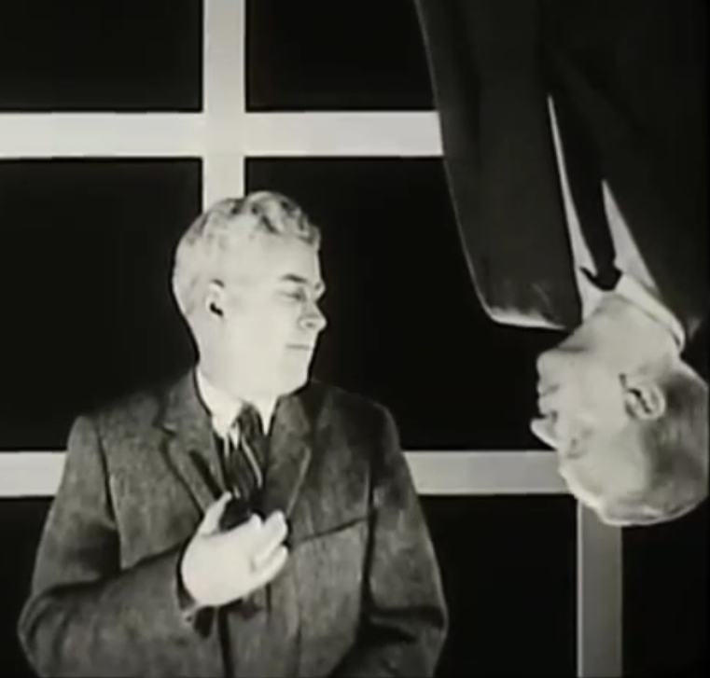
Notes:
Image of profs and clip of profs

Slide 5
Notes:
clip of barge

Slide 6
Notes:
Clip of rowers

Slide 7
Notes:
Clip of plane

Slide 8
Notes:
Clip of big bang

Slide 9
Notes:
Lady on a train

Slide 10
All motion is relative and must be measured as compared to a “stationary”object or a…
January 5
Frame of reference

Slide 11
Describing Motion
January 5
In order to properly describe the motion of anything we need to actually measure some fundamental properties
Notes:
we cannot simply trust what we “see”

Slide 12
Position
January 5
Location relative to a frame of reference
Notes:
Use xyz coordinate axes with origin to identify position of the projector

Slide 13
Distance
January 5
How far (length) from one position to another
Notes:
Basically just the position

Slide 14
Scalar quantity
January 5
Has a magnitude (size) only
Notes:
Examples like distance, mass, temperature…there will be questions as to what would be something that is not a scalar

Slide 15
direction
January 5
Which way
Notes:
Relative to a frame of reference

Slide 16
Vector quantity
Has magnitude and direction
Notes:
Vector clip from despicable me

Slide 17
Displacement
January 5
How far and which way
Change in position
Straight line distance between points
Notes:
3 definitions with examples 1. distance with direction; 2. walk straight from point A to B v. walk around room from A to B; 3. map/GPS example

Slide 18
January 5

Slide 19
time
January 5
Duration of an event
Notes:
Explain why “how long” is not the best definition…long can mean distance

Slide 20
speed
January 5 (4th block only)
How fast
Distance covered over a given amount of time
Notes:
Now put it all together…

Slide 21
velocity
Speed with a direction
displacement covered over a given amount of time
January 5 (4th block only)
Notes:
Now put it all together…

Slide 22
Lab: Keep on Truckin’
January 5 (4th block only)
Obj: Given a pair of constant speed toy trucks, verify the slow/fast labels using a graph of the data from both trucks.
Data…5 points
No calculations
One graph of data
Discussion…wait for day 2 to start

Slide 23
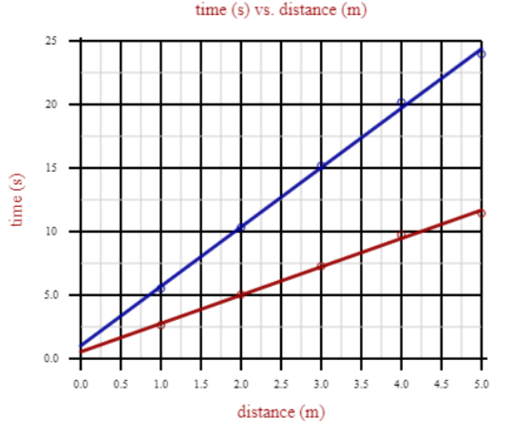
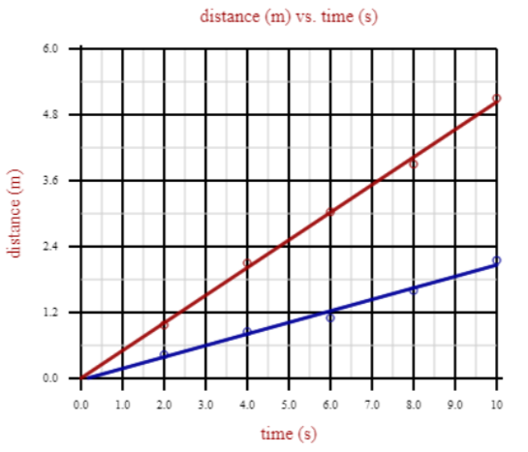
Aug 3

Slide 24
January 8

Slide 25
acceleration
Speeding up or getting faster
January 8
Notes:
Now put it all together…

Slide 26
acceleration
Slowing down or getting slower
January 8
Notes:
Now put it all together…

Slide 27
acceleration
Turning or changing direction
January 8
Notes:
Now put it all together…

Slide 28
January 8

Slide 29
January 8

Slide 30
August 5
January 9
Notes:
Position v time graphs

Slide 31
August 8
January 9
Notes:
Position v time graphs

Slide 32
January 9
Notes:
Position v time graphs

Slide 33
August 8
January 9
Notes:
Position v time graphs

Slide 34
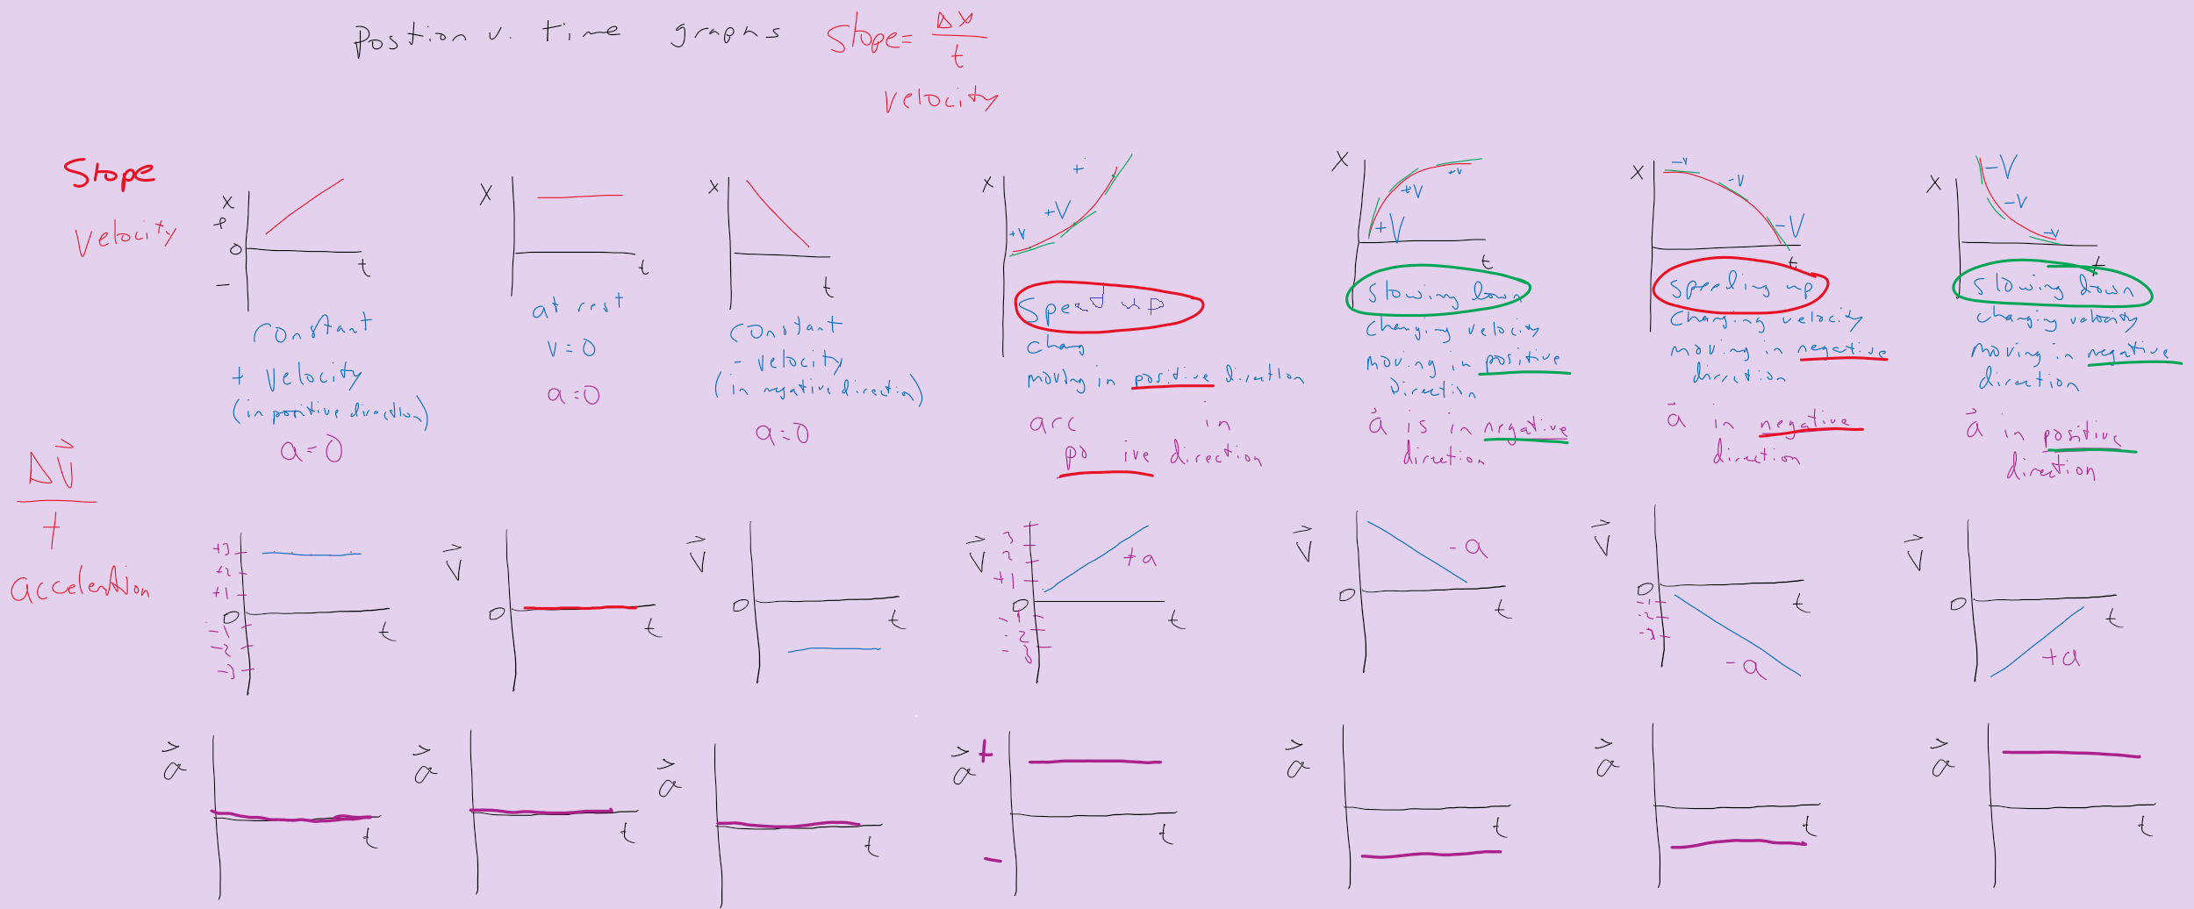
As of Jan 9
All motion graphs together on one slide…

Slide 35
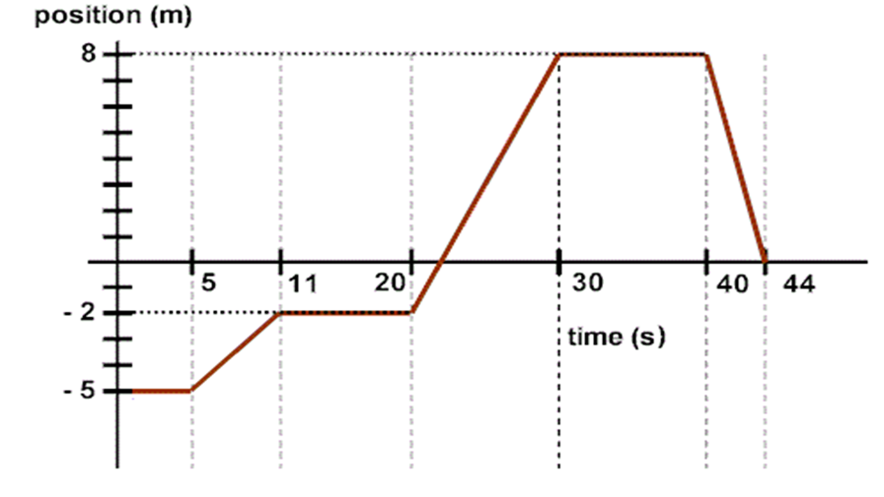
Jan 17

Slide 36
Jan 17

Slide 37
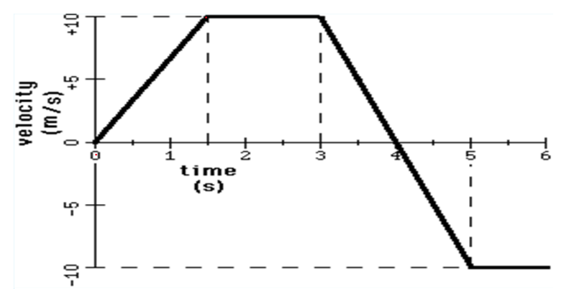
Jan 17

Slide 38
Jan 17

Slide 39
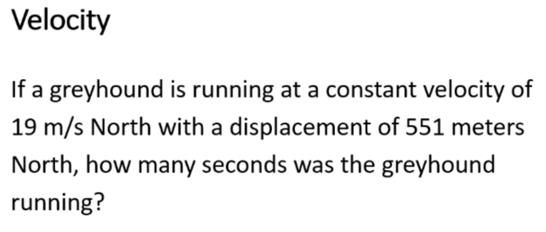

Slide 40
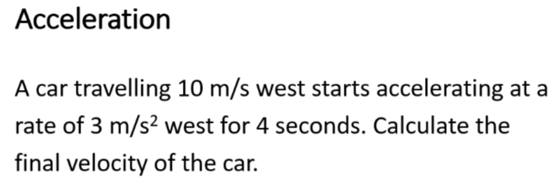

Slide 41
Skills Check – Solve one of the following…show proper work
The women’s world record for the 100.0 meter sprint was set by Florence Griffith-Joyner in 1988. When she set the record she had an average velocity of 9.533 m/s. What was the time of Florence Griffith-Joyner’s 100.0 m sprint?
A car has a velocity of +30 m/s when the driver suddenly speeds up with an acceleration of +4 m/s² for 10 seconds. Calculate the final velocity of the car.
Notes:
Fall 2022 velocity acceleration

