Slide 1
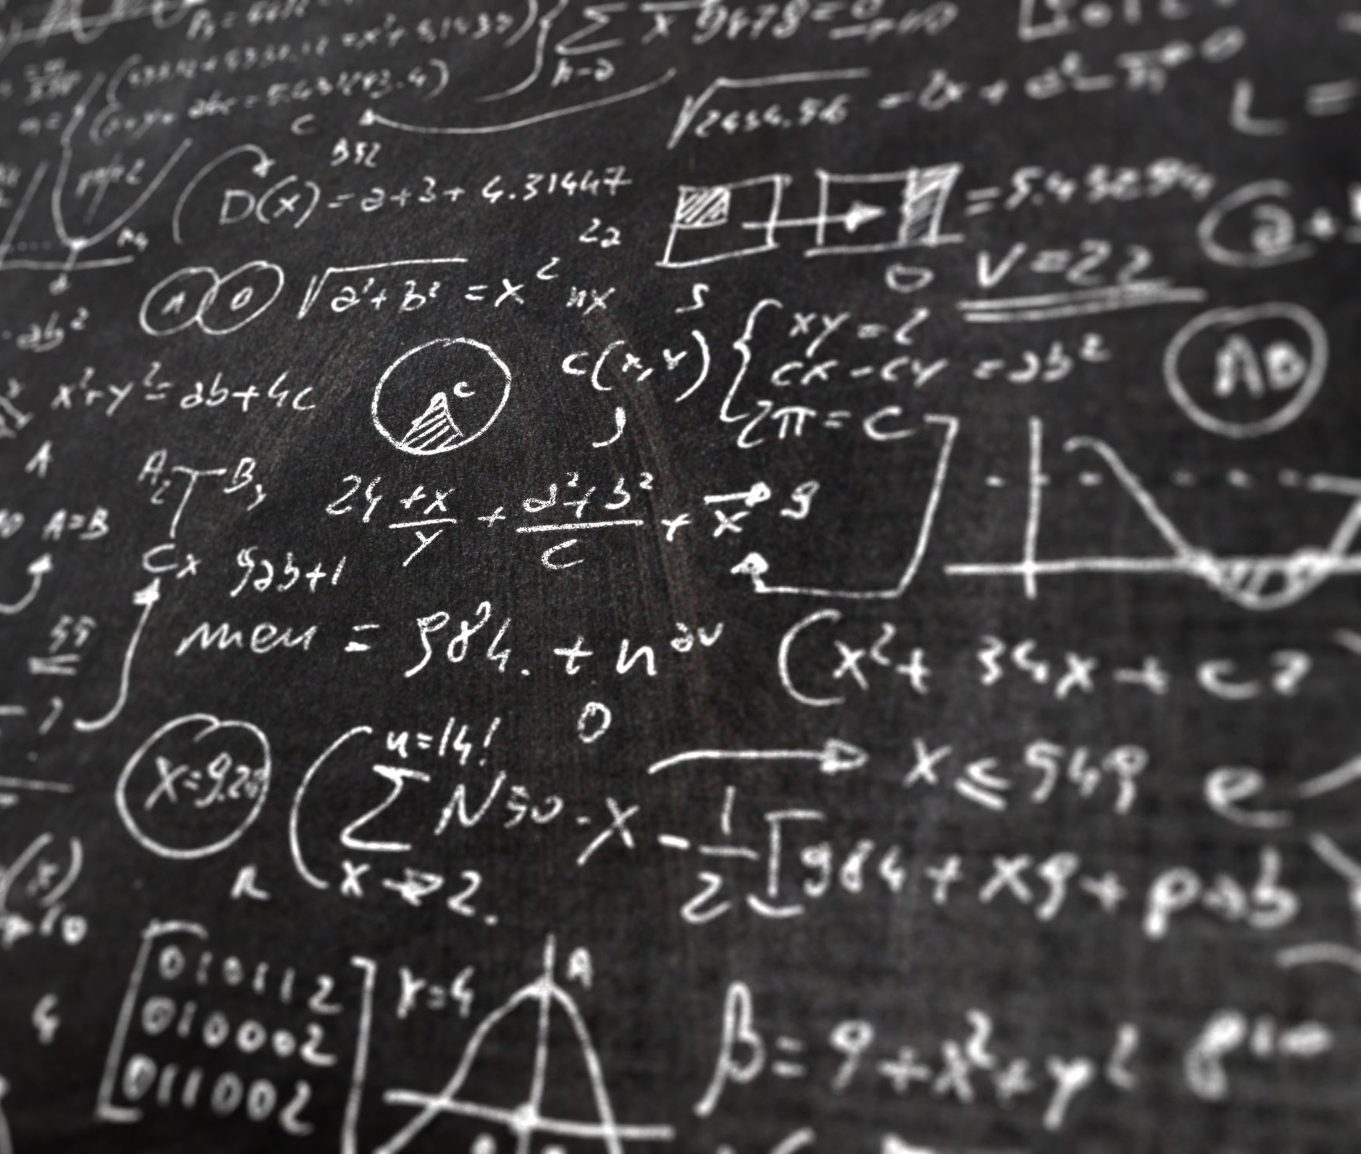
Energy and Momentum notes

Slide 2
March 11

Slide 3
March 11

Slide 4
March 11

Slide 5
Lab: People Power
Objective: Using a graph of your data, determine your vertical power while walking up a flight of stairs.
Data: your weight, # steps, rise of single step, time along the way
Calculations: weight conversion, work
Graph: The slope should equal your power
Discussion
March 11

Slide 6
March 12

Slide 7
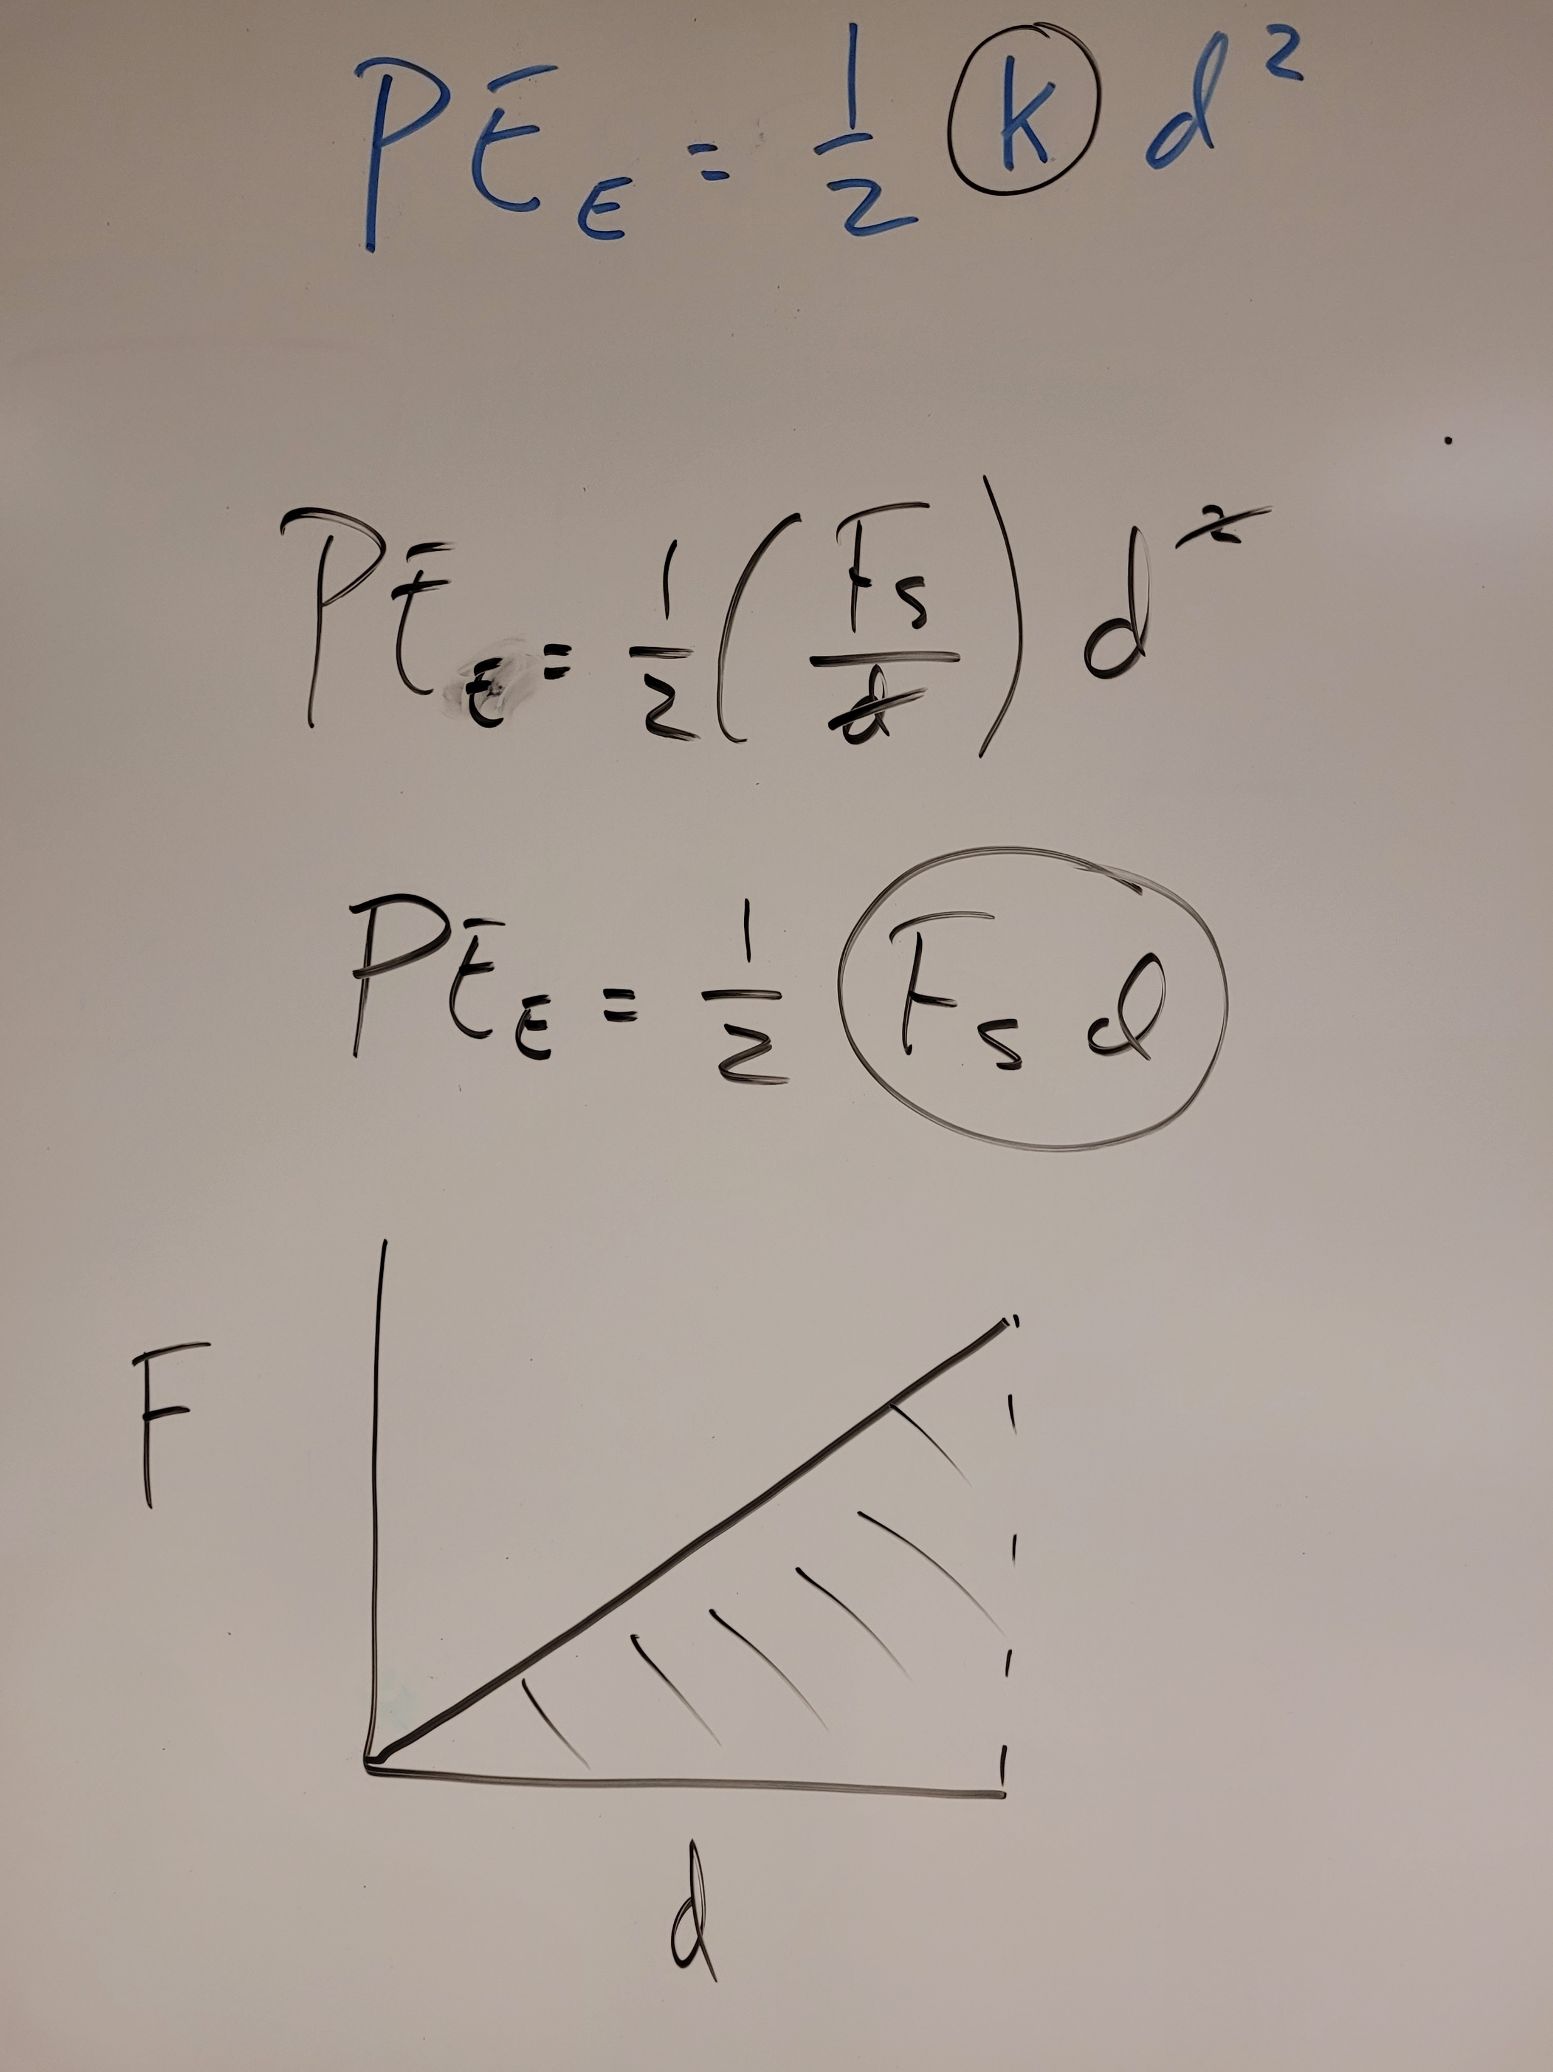
March 12

Slide 8
March 13

Slide 9
March 13

Slide 10
March 13

Slide 11
March 13

Slide 12
Conservation of energy example
First we need to determine the total energy in the cart at rest against the wall…
A 0.500 kg cart is at rest and placed against a wall. The spring (k = 2744 N/m) loaded plunger is engaged (Δx = 0.05 m).
E = KE + PE_{G} + PE_{E}
March 14

Slide 13
Conservation of energy example
Next we will use the total energy and conservation to determine the kinetic energy of the cart after it launches of the wall…
A 0.500 kg cart is at rest and placed against a wall. The spring (k = 2744 N/m) loaded plunger is engaged (Δx = 0.05 m).
E = KE + PE_{G} + PE_{E}
March 14

Slide 14
March 14

Slide 15
Conservation of energy example
And last we will use the total energy and conservation to determine how high the cart will roll up the incline…
A 0.500 kg cart is at rest and placed against a wall. The spring (k = 2744 N/m) loaded plunger is engaged (Δx = 0.05 m).
E = KE + PE_{G} + PE_{E}
March 14

Slide 16
March 14

Slide 17
Skills Check: More Conservation of energy
Show equations, substitutions, units.
Use the conservation of energy to determine how high the cart will be up the incline when it has slowed down to 2 m/s.
A 0.25 kg cart is initially moving with a speed of 5 m/s.
March 15

Slide 18
Lab: No Free Lunch
Objective: Design a roller coaster for a skater. Verify the law of conservation of energy as the skater moves along the track.
Follow the provided lab procedures and complete data collection, analysis, and discussion on lab sheet
Click to download the lab procedures
Upload your completed spreadsheet to the Lesson uploads in the Unit 4 Digital Session
March 18

Slide 19
March 19

Slide 20
March 19

Slide 21
March 19

Slide 22
March 19

Slide 23
March 20

Slide 24
March 20

Slide 25
March 20

Slide 26
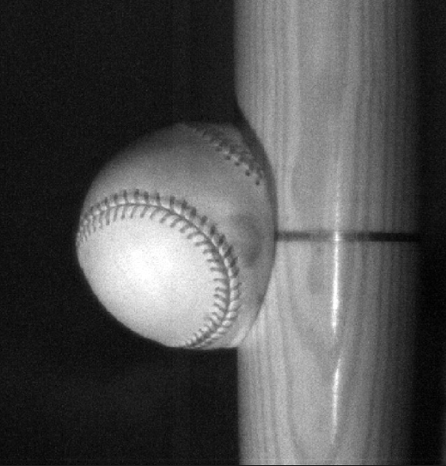
Skills Check: Impulse – Solve the following…show proper work and UNITS
A 0.145 kg baseball is pitched at 30 m/s East heading toward home plate. The ball is struck by the bat and heads straight back at 20 m/s West. The collision with the bat lasts 0.0007 s.
(a) What is the impulse delivered to the ball?
(b) What was the average net force applied to the ball?

Slide 27
March 22

Slide 28
March 22

Slide 29
March 25

Slide 30
March 25

