Slide 1
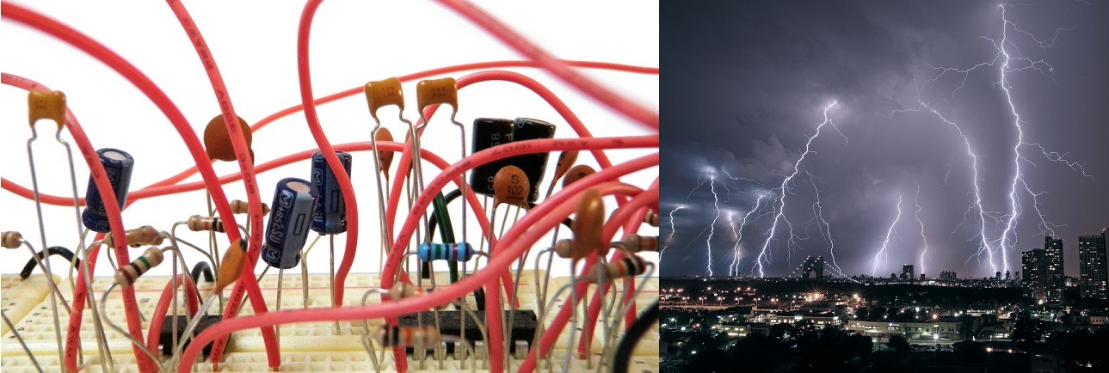
Electricity notes

Slide 2
March 29

Slide 3
March 29

Slide 4
March 29

Slide 5
March 29

Slide 6
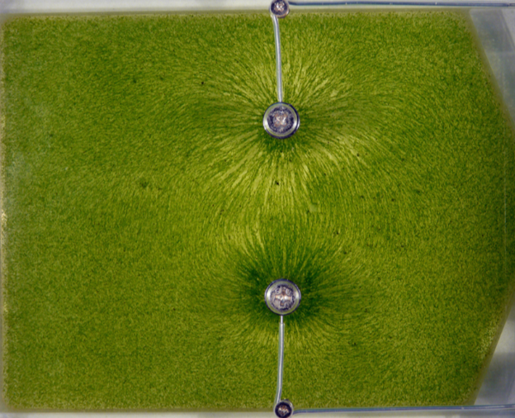
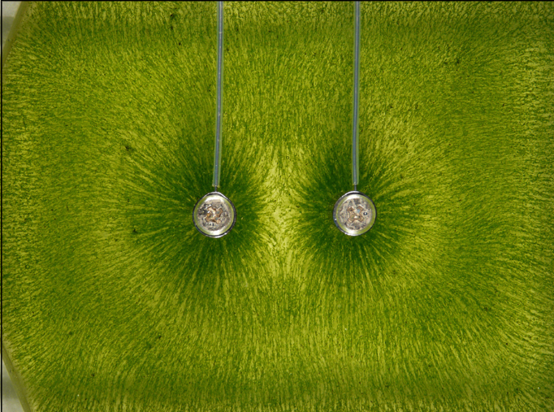
March 29

Slide 7
March 29

Slide 8
March 29

Slide 9
March 29

Slide 10
March 29

Slide 11
April 8

Slide 12
April 8

Slide 13
April 9

Slide 14
April 9

Slide 15
April 9

Slide 16
April 9

Slide 17
April 9

Slide 18
April 9

Slide 19
April 10

Slide 20
April 10

Slide 21
Lab: Ohm’s Law
Follow the provided lab procedures
Click to download the lab procedures
Record all data, show one calculation for each part, answer all questions, you should have two graphs and calculate the slope of the graph in Part 2
Discussion: None
April 10

Slide 22
Lab: Electric Circuits
Follow the provided lab procedures
Click to download the lab procedures
April 11

Slide 23
April 12

Slide 24
April 12

Slide 25
April 12

Slide 26
April 15

Slide 27
April 15

Slide 28
April 15

Slide 29
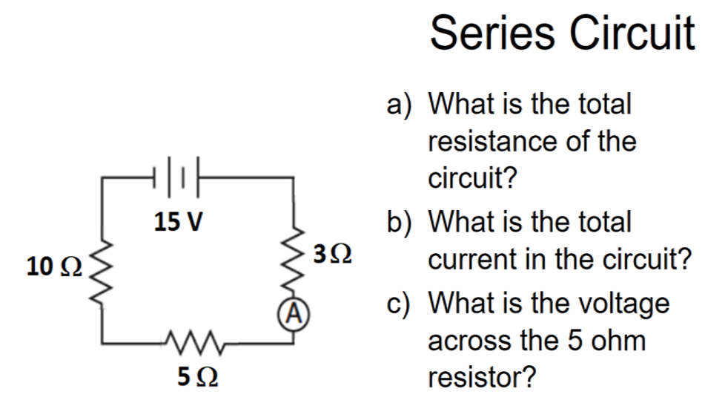
Skills Check – Solve one of the following circuits…show proper equations, work and UNITS
April 16

Slide 30
April 16

Slide 31
April 16

Slide 32
Electromagnetic Induction
April 17
Faraday’s Law
A changing magnetic field will induce a voltage in a wire and a resulting current
Either move magnet through wire, or move wire through magnetic field

Slide 33
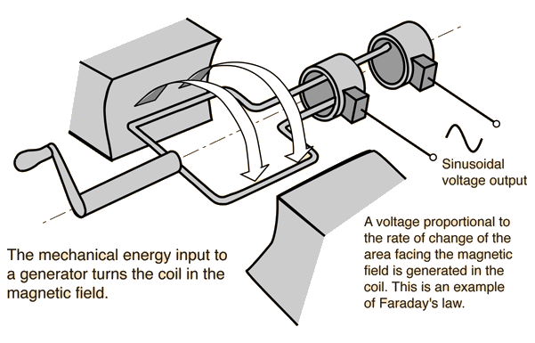
Generator
April 17
Spinning magnets near coils of wire induce a voltage and current
Alternating current (AC)—electrons move back & forth
on a large scale, we use steam (from coal or nuclear), water power, or wind to spin turbines

Slide 34
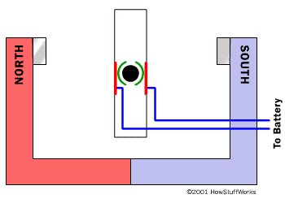
Motor
April 17
A movable electromagnet inside a magnetic field will spin the electromagnet
electrical energy to mechanical energy

Slide 35
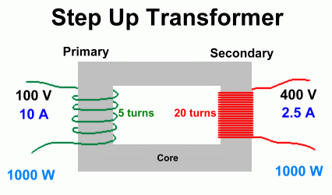
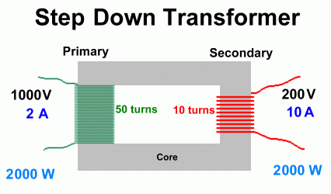
Transformer
April 17
AC current in one set of coils induces voltages in another set of coils
Step up coils = step up voltage
Step down coils = step down voltage

